Slide 1



ARTICULATION TASK FORCE (ATF)
Presented by: Office of Assessment & Curriculum

Slide 2





AZTRANSFER

Slide 3
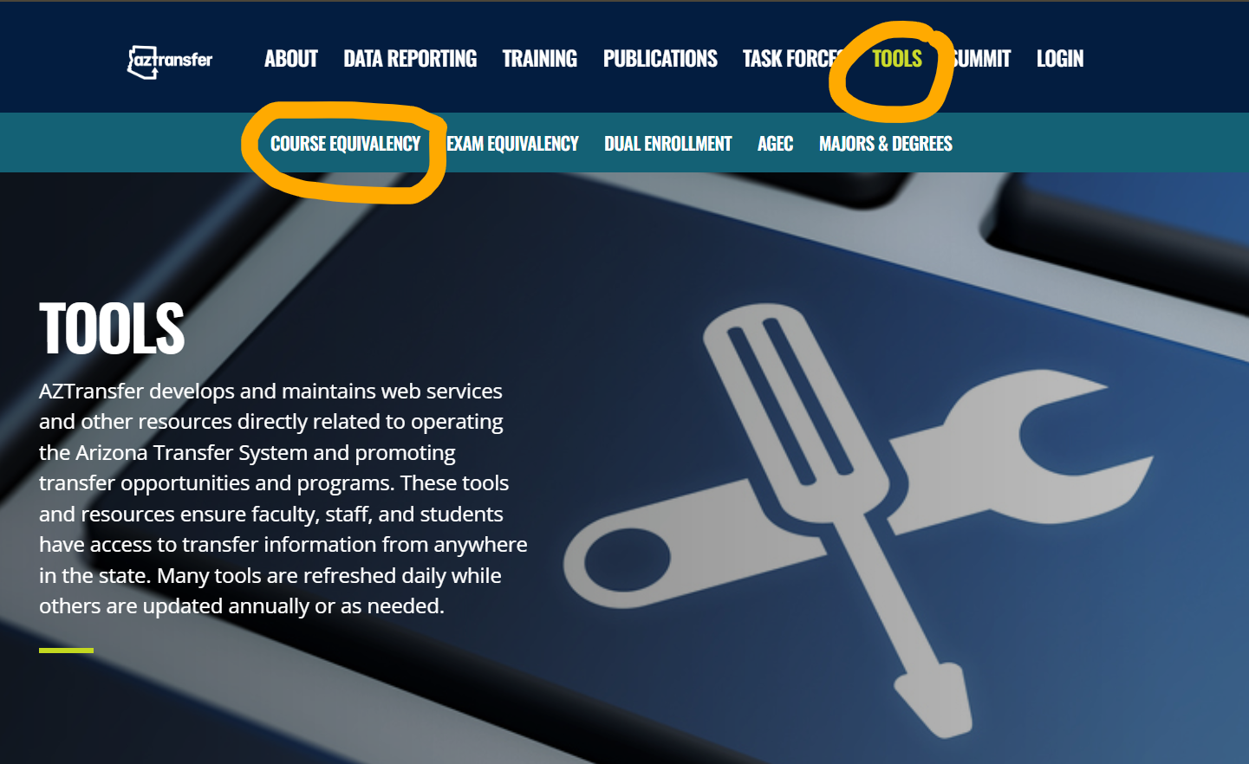
www.aztransfer.com/tools/

Slide 4


DISCIPLINE SPECIFIC TASK FORCES
Discipline specific Articulation Task Forces (ATFs) consist of faculty members appointed by their institutions to represent both the institution and their specific academic area(s). Discipline specific ATFs serve as a forum for public community colleges and universities to cooperatively exchange articulation information in a timely manner in order to actively participate in the implementation of the Arizona Transfer System.
DC represents 30/43 disciplines

Slide 5
HOW DISCIPLINE SPECIFIC ATFS WORK
Discipline specific ATFs meet annually to discuss transfer, curriculum, and articulation issues. Additionally, ATFs focus on planning for the future, ensuring student success, sharing developments, collaborating on partnership programs, and designing innovative programs for Arizona constituents.
Each institution/district with courses and/or programs that transfer into the corresponding baccalaureate degree(s) designates a Lead Member with voting privileges for that ATF. Other membership categories include Member, Liaison, and Alternate.

Slide 6


ATF ROLES & RESPONSIBILITIES
Lead Member - One individual faculty member officially representing his/her institution or district and has voting privileges.
Alternate - Faculty member attending in place of the Lead Member who also has voting privileges.
Member - A faculty representative in addition to the Lead Member who does not have voting privileges.
Liaison - A non-faculty individual who attend meetings for information or observation purposes and does not have voting privileges. AZTransfer meeting facilitators are identified as liaisons for discipline ATFs for the term in which they facilitate that meeting.
Listserv Only - Representatives who do not attend meetings but desire to be on the listserv for information or observation purposes.

Slide 7
ATF MEETING AGENDA
Specific agenda items reviewed before and during each ATF meeting include but are not limited to:
Course Equivalency Guide (CEG) information for all associated departmental prefixes;
Courses in the ATF Common Course Matrix (CCM);
University degrees associated with each ATF (completed by the university AZTransfer Facilitator);
College degrees associated with each ATF;
Equivalencies in any related exam matrices;
Changes in university general education requirements;
Curricular changes in courses, programs, and degrees that impact course transfer;
The statewide update, presented by the AZTransfer Facilitator assigned to the ATF meeting, which informs participants about changes to AZTransfer and other information that impacts student transfer;
Status and/or results of special projects;
Information from the AZTransfer Steering Committee;
Items tabled from prior meetings that need to be addressed;
Selection of next year’s chair, host, meeting date, time, location, note taker, and format (e.g. face-to-face, virtual, etc.).

Slide 8
GOAL & OUTCOMES OF ATF MEETINGS
The preparation and efforts of ATF meeting participants result in the successful implementation of the Arizona Transfer System to ensure the community college students transfer to Arizona public universities with maximum application of earned college credits toward a baccalaureate degree.
Discipline specific ATFs make recommendations to:
Confirm current baccalaureate degrees within the discipline specific ATF and categories/pathways that articulate with the two-year transfer degrees.
Ensure, where applicable, that a minimum of six common lower-division credits for shared majors are identified (Common Courses).
Select/affirm the appropriate Arizona General Education Curriculum (AGEC) as part of the lower division preparation for baccalaureate degrees associated with the discipline specific ATF.
Update the Course Equivalency Guide (CEG).

Slide 9
GOAL & OUTCOMES OF ATF MEETINGS
CONT’D
Discipline specific ATFs provide mechanisms for anticipating and/or resolving transfer issues by:
Communicating accurate information regarding university degree program requirements and the transferability of community college courses to those programs.
Posting the completed ATF report and meeting notes within 14 days, including:
Institutions and names of ATF members represented at the meeting.
New, confirmed, or changed pathways.
New, confirmed, or changed common courses.
New, confirmed, or changed exam equivalencies.
New agreements regarding any of the five exam programs.
New, confirmed, or changed agreements for any of the five exam programs.
Summary of addressed agenda items that require follow-up.
Summary of issues to be shared with the AZTransfer Steering Committee.
Programmatic changes under development:
Identifying the impact of proposed programmatic changes at the tribal and community colleges or universities which may affect the transferability of credits.
Identifying the impact of proposed changes on courses, including SUN courses.

Slide 10
AZTRANSFER FACILITATOR
AZTransfer Facilitators are representatives from the Arizona public community and tribal colleges and the three state universities. Each institution has responsibilities at both the institutional and statewide level for managing the operational procedures supporting transfer articulation in Arizona. These responsibilities include oversight and coordination of processes and procedures related to ongoing maintenance of course equivalencies, transfer tools in AZTransfer, and ensuring that institutional faculty and staff are familiar with the Arizona Transfer System. AZTransfer Facilitators should remain current with the components of AZTransfer by reading the meeting notes from the discipline and non-discipline specific ATF meetings.

Slide 11
THANK YOU!

