Slide 1

Assessment Days December 17 & 18, 2024
Office of Assessment & Curriculum
Office of Provost

Slide 2
Day 1
Office of Assessment & Curriculum
Office of Provost

Slide 3
Team introductions
Housekeeping and Goals for Assessment Days
HLC timeline and website
Provost Landry

Slide 4
Introductions – Provost & OAC
Mikayla Largo, Director of Assessment and Curriculum
Kendra Begay, Assessment Database Specialist
Jerad Kozey, Instructional Designer
Miranda James, Administrative Assistant

Slide 5

Housekeeping & Goals - Provost
Acknowledge assessment work completed in Fall 2024.
Revisit expectations for the HLC visit in November 2025.
Provide the skills and resources for faculty and programs to get as much work done as possible.
Remember that we're not just responding to the HLC. We're building a culture of reflection and continuous improvement.
Keep communication on-topic; recognize that the Assessment Team is here to help. We're working together toward a common goal.

Slide 6
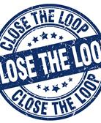
How did we get here?
Diné College has a history of not drawing meaning from academic assessment activities
Historically, some faculty have done a good job of "archiving" student work, but not analyzing it based on specific student-learning outcomes
We have tried several different models/structures for assessment, including a top-down approach (dictated by administration) and a bottom-up approach (faculty-driven). Most recent efforts came from faculty committees.
We have also engaged in conversations with other TCU's and explored alternative methods for assessment
However, we still have a track record of getting "dinged" by our accrediting agency for not "closing the loop"

Slide 7

FRUSTRATION

Slide 8

… But we're not alone!
According to the HLC's 2023 Comprehensive Report, Core Component 4.B continued to be the most frequently cited area of concern, with citations in 27% of all the comprehensive evaluations.

Slide 9
ACKNOWLEDGE THE PAST – Work TOWARD THE FUTURE
Why Faculty-Driven Assessment Didn't Work:
No central oversight; No central repository
Relied on faculty who didn't necessarily have expertise in academic assessment
No single source of "assessment truth"
Assessment training was left to the faculty; it often got lost among other commitments
Relied on faculty policing (nagging) each other
How Our New Plan Addresses Concerns:
Central oversight from Office of Assessment and Curriculum, but regular input from faculty and faculty committees
OAC takes the burden of designing assessment plan and training faculty
While faculty implement the plan, OAC does the nagging
One source of "assessment truth." Repository of information overseen by OAC

Slide 10
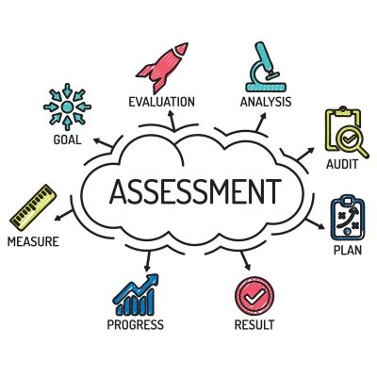
A new culture of Assessment
Assessment plan based on most recent trends in higher education assessment, but that also reflects our unique culture and needs
Plan that lays out the basic structure, but allows leeway for each individual and program to determine what works best for them
Process that worries less about checking the boxes for HLC accreditation and focuses instead on building a culture of reflection and continuous improvement
Office and Assessment and Curriculum operates as a partner or resource to assist faculty with their assessment goals

Slide 11
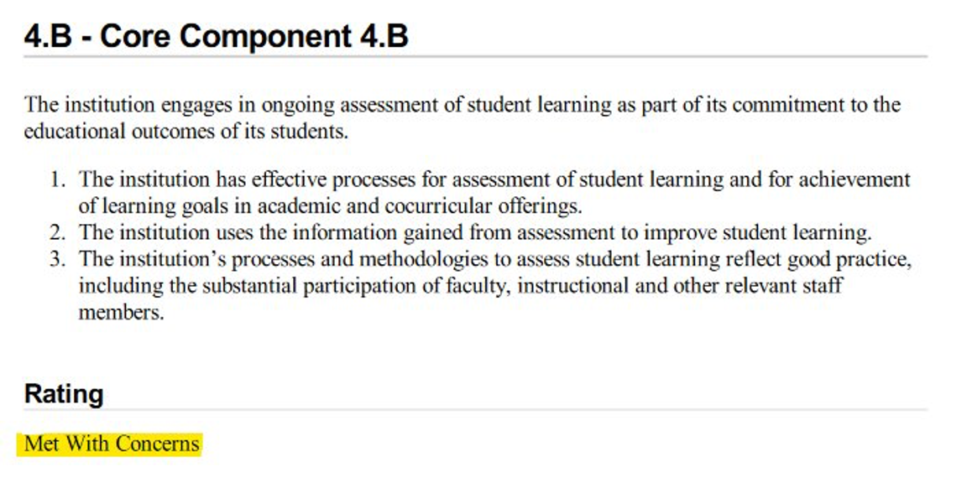
Expectations for the HLC Visit (Nov. 17-18, 2025)
Focused visit: HLC reviewers will focus mainly on the area where we got dinged in 2023 -- Criterion 4.B, or assessment of student learning.
Reviewers may look at other areas if they come up.

Slide 12
Concerns that must be addressed by the 2025 visit
Clarification and refinement of the current assessment processes to ensure faculty and staff understand the processes sufficiently to engage in meaningful assessment of student learning outcomes.
Evidence of substantial involvement of faculty in refinement and implementation of assessment processes.
Evidence of systematic acceptance and implementation of faculty-approved assessment plans in each of the areas of institutional, general education, and program learning outcomes.
Evidence of analysis/discussion of student learning outcome assessment data.
Evidence of use of student learning outcome data to inform changes in each of the areas of academic programs, general education, and co-curricular units.
Evidence of linkage between assessment data and budgeting, where appropriate.
Ongoing professional development in assessment for all faculty to develop the necessary tools to promote a culture of continuous improvement through assessment.

Slide 13
CONCERN
EVIDENCE
Clarification and refinement of the current assessment processes to ensure faculty and staff understand the processes sufficiently to engage in meaningful assessment of student learning outcomes.
Evidence of substantial involvement of faculty in refinement and implementation of assessment processes.
Evidence of systematic acceptance and implementation of faculty-approved assessment plans in each of the areas of institutional, general education, and program learning outcomes.
Evidence of analysis/discussion of student learning outcome assessment data.
Evidence of use of student learning outcome data to inform changes in each of the areas of academic programs, general education, and co-curricular units.
Evidence of linkage between assessment data and budgeting, where appropriate.
Ongoing professional development in assessment for all faculty to develop the necessary tools to promote a culture of continuous improvement through assessment.
Faculty input when hiring an Assessment Director
Assessment of Assessment Report
Revised Assessment Handbook
Meeting invitations/notes with faculty/programs
Notes from Sihasin Committee; revisions to plans and processes submitted by faculty
Ongoing assessment of assessment
Assessment Days agendas
Approval of new plan from Sihasin Committee; Notes from Gen Ed Committee meetings; Completed report templates; Notes from meetings with faculty/programs
Completed assessment templates; proof of faculty engagement with assessment data during Assessment Days and beyond
Changes made to syllabi, assignments, curricula, etc.
Budget sheets
Faculty surveys
Sign-in sheets at Assessment Days

Slide 14
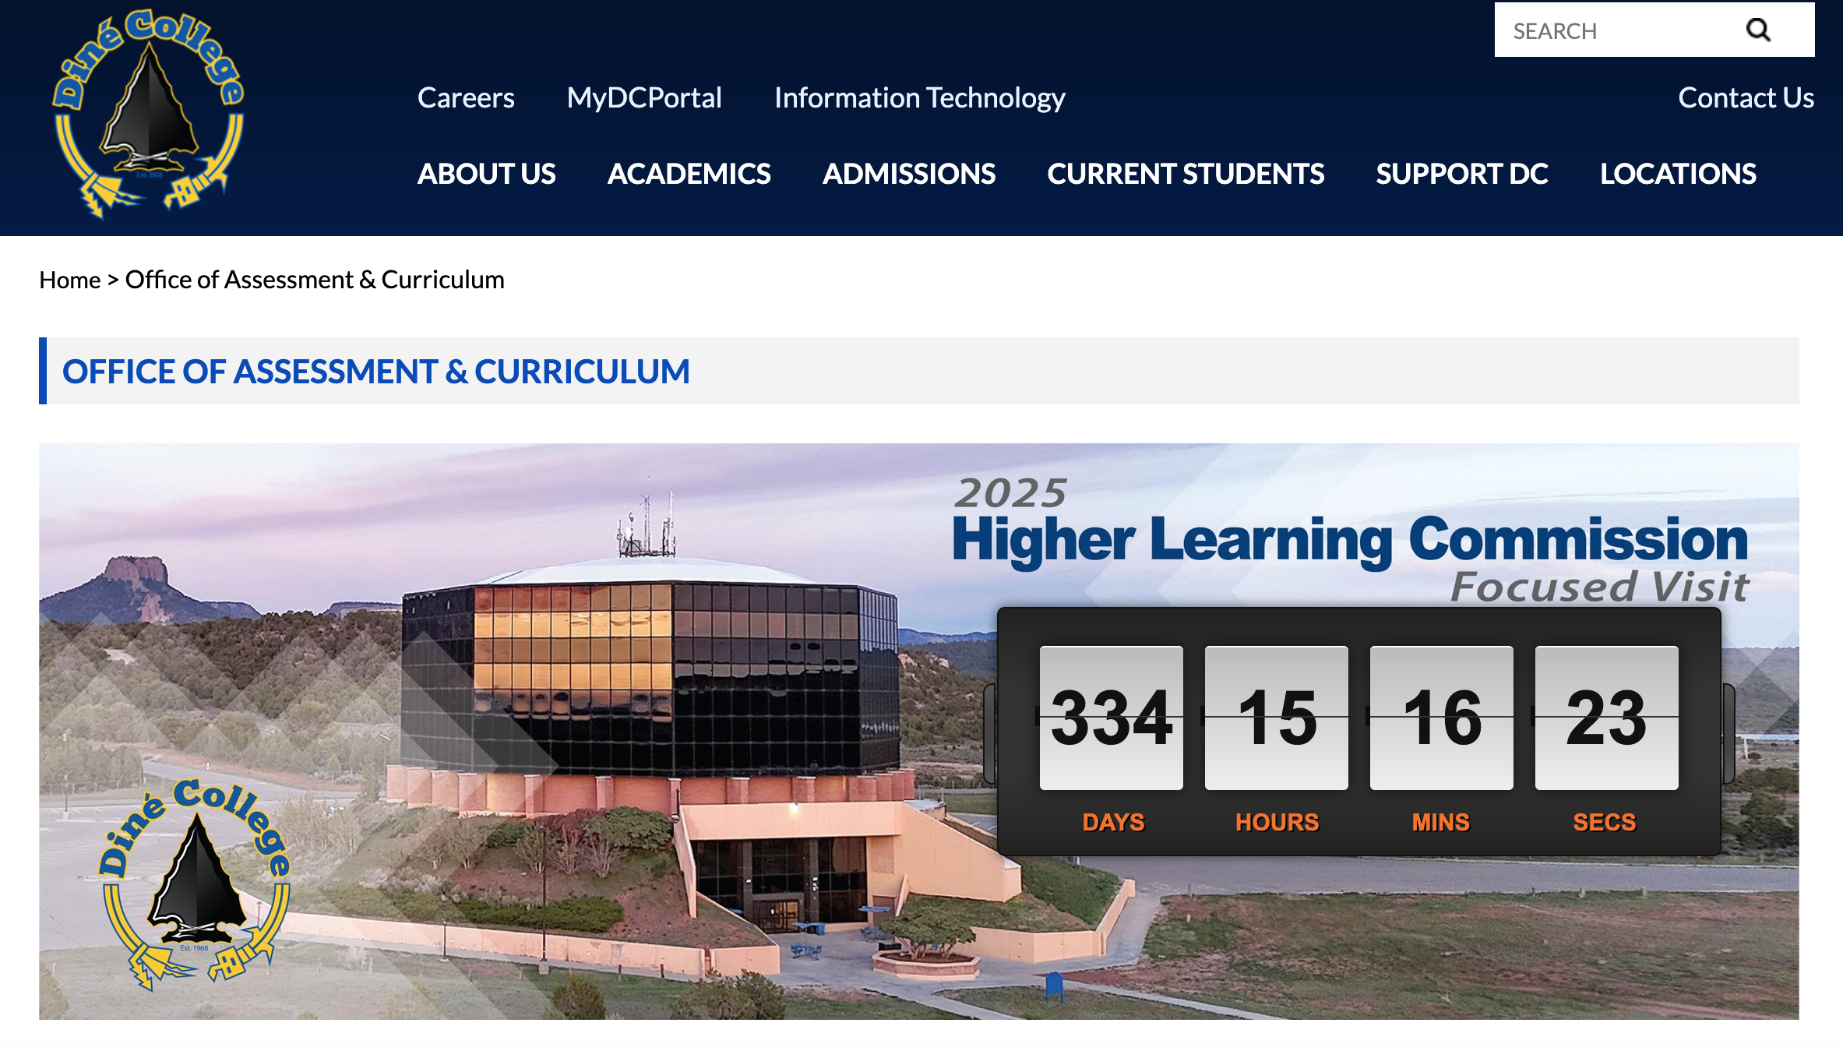
A Culture of Transparency

Slide 15
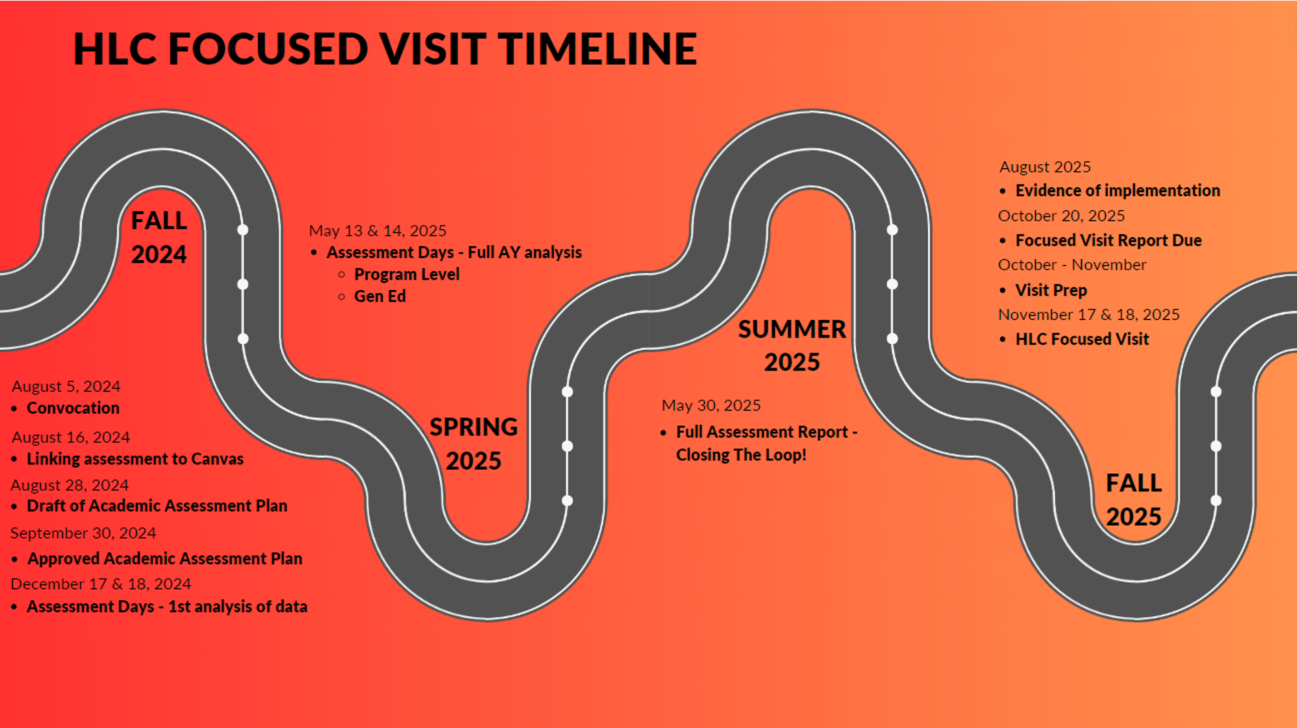

Slide 16
The Big Picture
No more assessment findings when the HLC reviews Diné College
Deep understanding of the health of our academic programs; cycle of review and improvement
Concrete, stated goals for students who enroll in programs – communicated throughout the Diné College community
Resources and assistance to help faculty achieve their goals in the classroom
When a student walks across the stage at graduation and received a diploma, we can feel confident that they are prepared to succeed in their chosen fields

Slide 17
Questions?

Slide 18
Acronyms
Assessment Updates
Different types of assessment at DC; Course, Program, Gen Ed, Co-Curricular & Academic Program Review (APR)
Assessment Accomplishments from Fall 2024
Common themes about assessment among programs
Mikayla Largo

Slide 19
acronyms
OAC – Office of Assessment and Curriculum
PSLO – Program Student Learning Outcome
ILO – Institutional Learning Outcome
APR – Academic Program Review
HLC – Higher Learning Commission

Slide 20
Course Level VS. Program Level Assessment
Program Level Assessment: a systematic process of evaluating the effectiveness of an entire academic program by examining how well students are achieving the learning outcomes set for that program, essentially assessing the collective impact of the program on student development and learning across several of its courses, rather than just an individual class; its primary goal is to use this data to improve the program overall.
EXAMPLE: Students completing the BS in mathematics should be able to analyze and interpret data to produce meaningful conclusions and recommendations and explain statistics in writing
Course Level Assessment: is a process of systematically examining and refining the fit between the course activities and what students should know at the end of the course. Course-level assessment measures how well students are meeting course outcomes and identifies areas for improvement. It also provides feedback to students on their learning and the course itself. Course outcomes should be in the course syllabus. Outcomes are measured by faculty teaching the course.
Upon completion of X course, students will be able to:
Discuss the common characteristics of plant growth hormones.
Apply XYZ business techniques to solve problems.
Illustrate the components of DNA.
Notes:
https://learning.northeastern.edu/course-assessment/#:~:text=Course%2Dlevel%20assessment%20is%20a,the%20end%20of%20the%20course.
https://provost.missouri.edu/programs-centers/program-assessments/assessment-of-student-learning/program-level-assessment/#:~:text=Program%20level%20assessment%20evaluates%20the,in%20achieving%20its%20program%20outcomes.

Slide 21
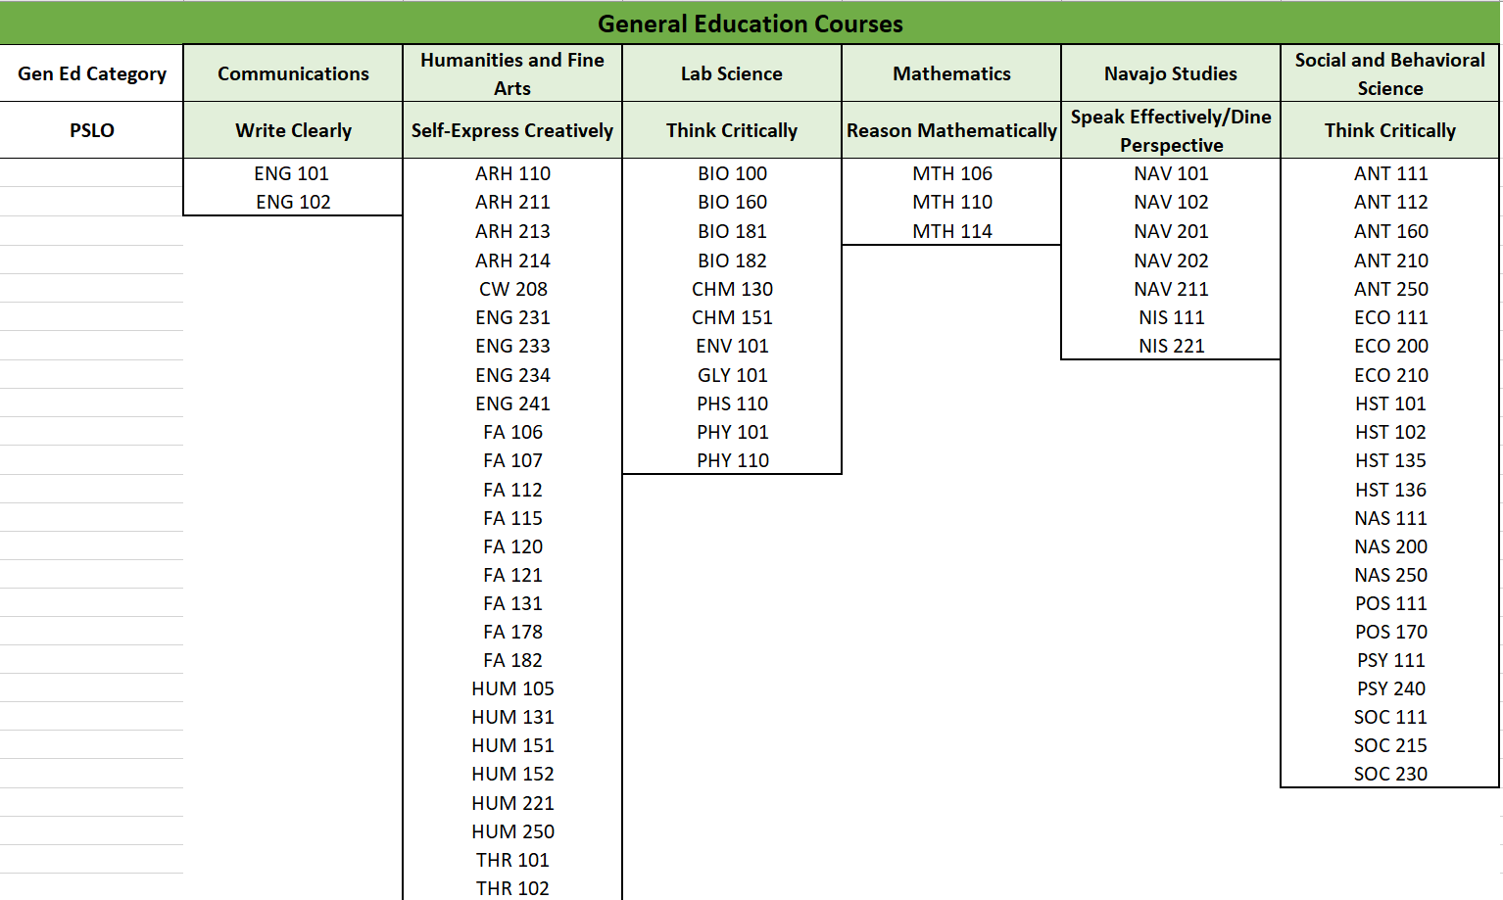
General Education
General Education Assessment: The philosophy of general education at Diné College is to ensure graduates have a knowledge base and skillset for engaging as effective members of their community and the world. Gen Ed Assessment is conducted at the program-level rather than course-level. All courses listed under Gen Ed are assessed according to a set of program student learning outcomes, using a rubric that measures the PSLO across a group of courses.
Notes:
https://learning.northeastern.edu/course-assessment/#:~:text=Course%2Dlevel%20assessment%20is%20a,the%20end%20of%20the%20course.
https://provost.missouri.edu/programs-centers/program-assessments/assessment-of-student-learning/program-level-assessment/#:~:text=Program%20level%20assessment%20evaluates%20the,in%20achieving%20its%20program%20outcomes.

Slide 22
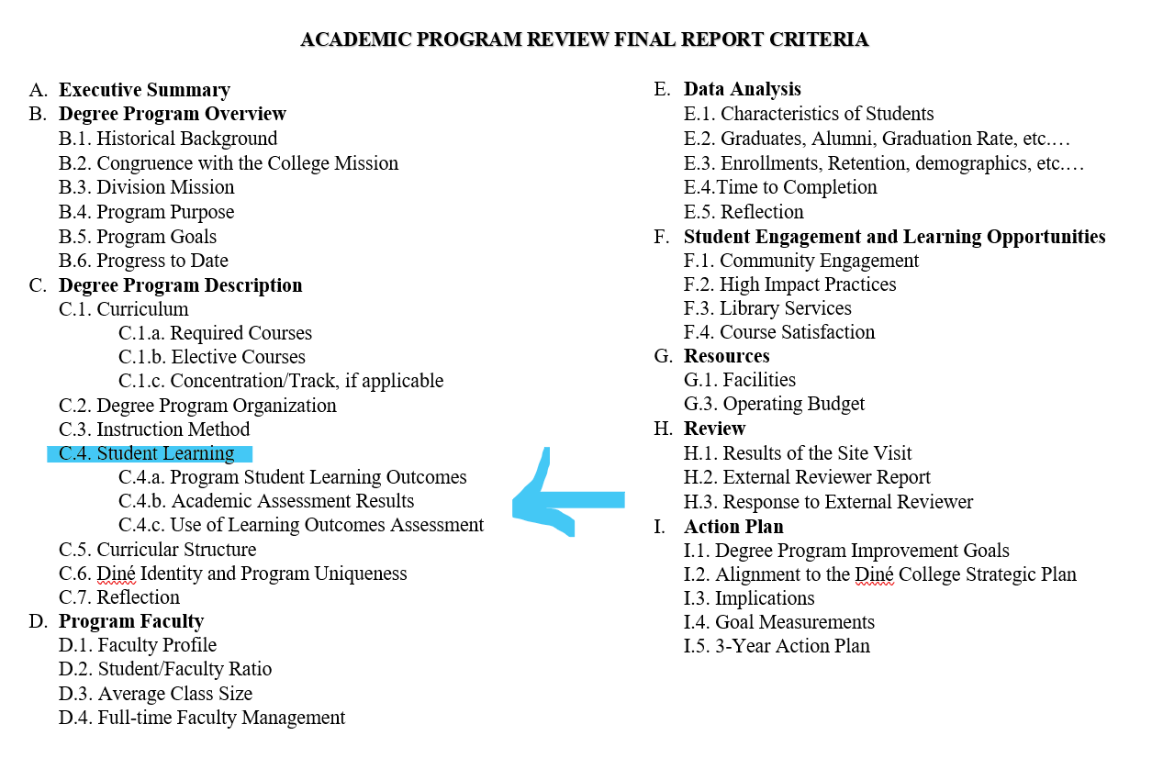
Academic Program Review
Academic Program Review (APR): The purpose of Academic Program Reviews (APR) at Diné College (DC) is to assess the quality, viability, and effectiveness of degree programs within each academic school, comprehensively. The APR process is one piece among numerous assessment measures utilized by the institution to prioritize and strategize improvements.
Notes:
https://learning.northeastern.edu/course-assessment/#:~:text=Course%2Dlevel%20assessment%20is%20a,the%20end%20of%20the%20course.
https://provost.missouri.edu/programs-centers/program-assessments/assessment-of-student-learning/program-level-assessment/#:~:text=Program%20level%20assessment%20evaluates%20the,in%20achieving%20its%20program%20outcomes.

Slide 23
Program Assessment and Evaluation
Course Level Assessment
General Education
Academic Program Review
Focuses on a specific course to determine if students are meeting the course outcomes upon completion of a course.
All courses listed under Gen Ed, have specific PSLOs in which students should be able to demonstrate basic knowledge and skills in critical thinking, communication, diverse perspectives, creativity, etc.
Comprehensive evaluation of an academic program, focusing on quality, viability and effectiveness. Several criteria is examined by internal administration and an external reviewer. This process is important for program improvement, new program development or even program sunsetting.
Program Level Assessment
Focuses on program student learning outcomes and what a student should be able to demonstrate after completing a program.
Co-Curricular
Learning activities, programs and experiences that reinforce the Diné learning principles of Są’ah Naagháí Bik’eh Hózhóón complement the college/academic curriculum. They are not graded, do not provide academic credit, and often occur outside regular school hours.

Slide 24
Accomplishments: Fall 2024
27/44 Programs met with the assessment team, and started or completed section 1 & 2 of the assessment report.
Of the 27 programs, 10 programs revised their program student learning outcomes.
One program completed an overhaul of revisions for their program; revised PSLOs, selected courses to assess different genres of writing and created a rubric to measure their PSLOs.
1 on 1 program meetings facilitated healthier conversations about what assessment is, the purpose and how it is different from other types of assessment at Dine College.
Academic Deans attended several of the program meetings and contributed to meaningful conversations about assessment for their specific programs.
Revised the Academic Assessment Handbook, still in review by the Sihasin Committee.
In partnership with Student Affairs, a streamlined assessment process is established for co-curricular and academics.

Slide 25
Programs that met with OAC – Fall 2024
SAH
SBSS
SDSE
STEM
CERT- Computer Technology
CERT-Medical Assistant
CERT- Public Health
AS Biology
AS Environmental Science
AS Agroecology/Environmental Science
AS Health Occupation
AS Pre-Engineering
BS Biology
MS Biology
AS Public Health
BS Public Health
BS Biomedical Science
BFA Creative Writing
BFA Digital Photography
Minor- Native American Studies
AAS Business Management
AA Business Administration
AA Social & Behavioral Science
BA Business Administration
BA Psychology
CERT- Navajo Nation Leadership
BA Elementary Education
BA Navajo Language
BA Education- Multi-Cult. Education
AA Dine Studies
BA Dine Studies
Completed at Assessment Days
AS Math
AAS Office Admin

Slide 26
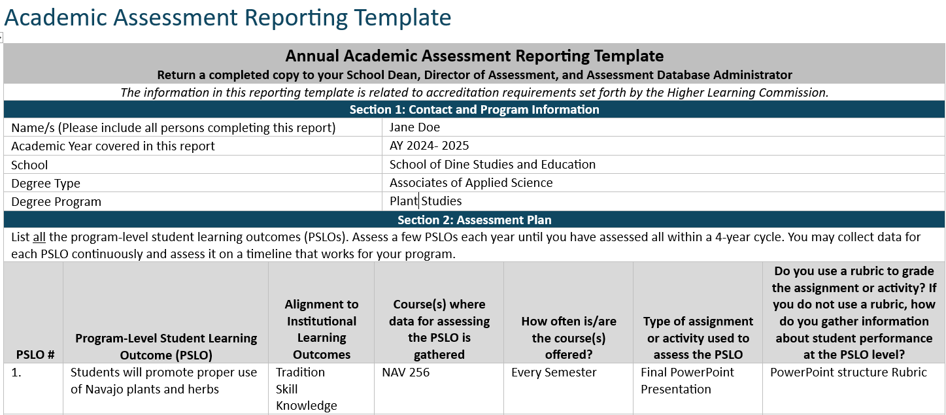
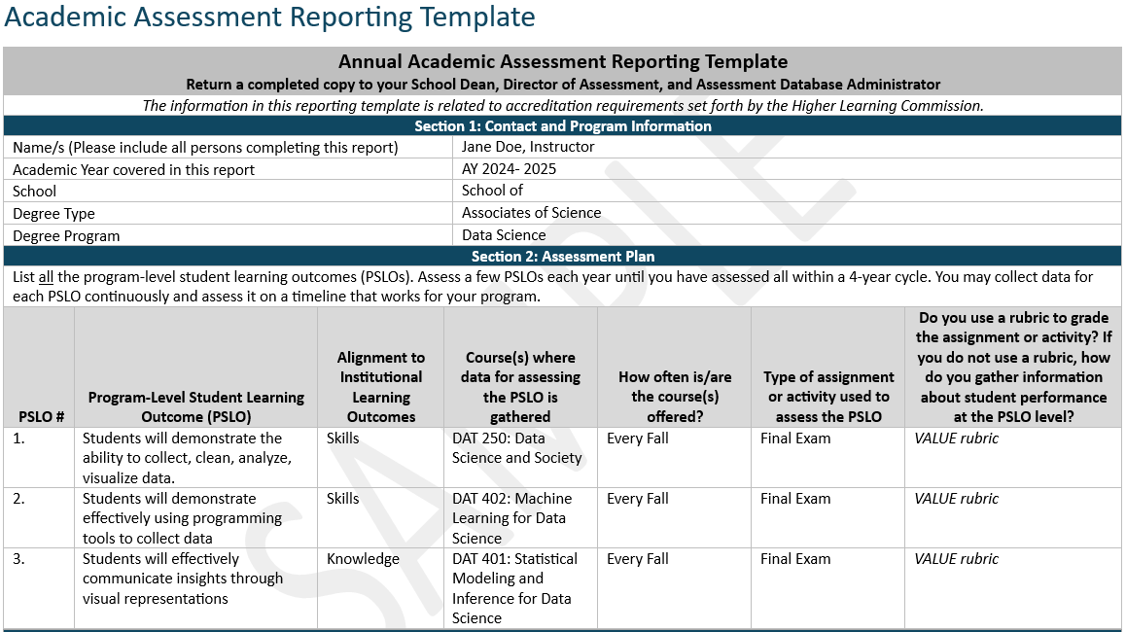
Common themes across programs
Unclear understanding of the different types of assessment and mixed understanding of: program level, course level assessment, assessment of Gen Ed and how the Academic Program Review is involved.
Program-level assessment is NOT evaluation of instructors an/or individual courses.
Program Student Learning Outcomes (PSLOs) have not been revised since the program was created.
Artifacts are being measured at the course level and not the program level. Example, BA Psychology
One or more courses are being used to assess more than one PSLO, without different artifacts. Example, AAS Business Management

Slide 27
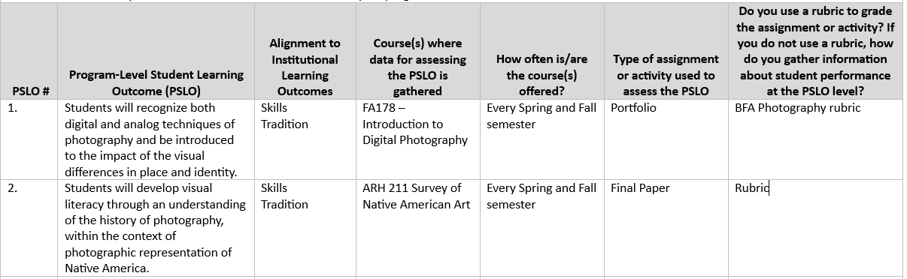
Common themes across programs
Programs select General Education courses, that are meant to be assessed by Gen Ed rubrics according to the SLO. -→
Courses that are not regularly offered are still listed as courses designated for assessment.
Program leads are not communicating to program faculty, that if their course is a designated course for assessment, artifacts will be used to measure the programs PSLO.

Slide 28

Lunch break!
Sign-in sheet at the Diné College cafeteria
Reconvene at 1:00 PM

Slide 29
Program Assessment Report work session
Developing Program Student Learning Outcomes
Direct & Indirect Measures
Questions for faculty
Resources to create a rubric
Faculty will break into groups by their programs to review Program Assessment Plan (section 1&2). This includes; Review/Revise PSLOs, identify courses and artifacts that can measure at the program level.
Programs that completed section 1&2, can begin section 3 – 7 (Analyzing and Making Decisions based on findings)
Mikayla Largo

Slide 30
Developing program student learning outcomes
What is a program student learning outcome? Clear and concise statements that outline what a student should be able to demonstrate upon completing the program.
What knowledge, skills, and attitudes/values should the ideal student graduating from our program demonstrate?
How will they be able to demonstrate these?
How does our program guide students to reflect and think critically about equity issues as well as different perspectives and ways of knowing?
How well does our program prepare students for careers, graduate school, professional study, and/or lifelong learning?
What evidence can we use to demonstrate growth in students’ knowledge, skills, and attitudes/values as they progress through our program?

Slide 31
Measuring PSLOs
Direct Measures: assessment methods that directly evaluate student work products or performances.
Rubric scores for capstone projects, senior theses, essays, exhibits, portfolios or performances
Pass rates/scores on comprehensive licensure or certification exams
Student publications or conference presentations
Indirect Measures: methods that gather data about student perceptions, opinions, and experiences related to their learning, providing insights into whether they believe they have acquired the intended skills and knowledge, but without directly demonstrating those abilities through a tangible performance or product
Focus groups with students, faculty, or employers
Student perception, program graduate and program alumni surveys
4-year school transfer or job placement

Slide 32
Questions for the programs and Things to consider
Courses selected for assessment; if ONLY taught by adjunct faculty, how do we move forward with including adjunct to utilize the program assessment rubric and submit artifacts?
If courses are already being assessed at the Gen Ed level, and you still plan to assess the course, how will you assess your Gen Ed courses within your program?
Consider removing 200 level courses in the Gen Ed core and focus assessment for those courses within the program.
How do you plan to measure your PSLO? Example, rubrics, surveys, passing rates of certification exams or licensure tests, student publications or conference presentations.
Programs that are not offering courses, or courses have not been offered in more than 3 consecutive semesters
How do we move forward with courses NOT taught in Canvas?

Slide 33
Creating a rubric for your artifact
http://rubistar.4teachers.org/
https://www.aacu.org/initiatives/value-initiative/value-rubrics

Slide 34
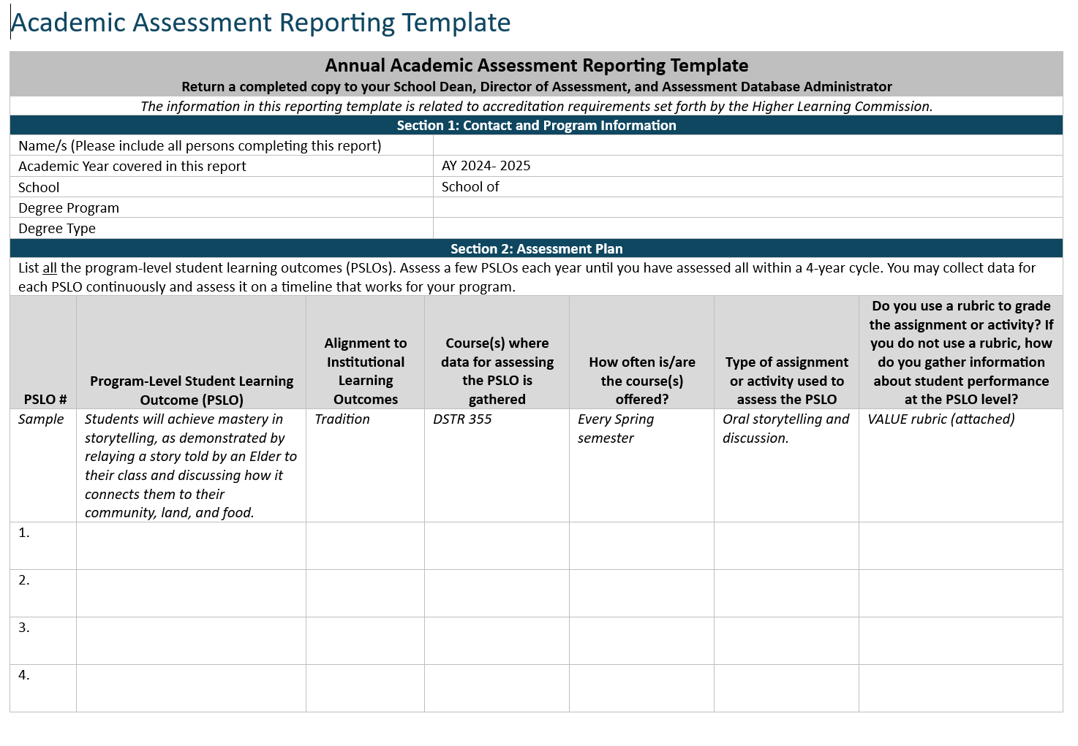
Annual academic assessment report
Section 1: Contact and Program Information
Section 2: Assessment Plan

Slide 35

See you tomorrow!

Slide 36
Day 2
Office of Assessment & Curriculum
Office of Provost

Slide 37
Program presentations

Slide 38
Program Faculty presentations
Three programs will be asked to present:
Program Student Learning Outcomes
Courses and artifacts selected for assessment
How will the PSLO be measured?
Two programs will be asked to present:
Analysis of their PSLO from Fall 2024 data
Findings and next steps
Faculty teaching Gen Ed courses: ENG101 and ENG102 will be asked to present:
PSLO for Write Clearly
Rubric for Write Clearly
Experience using Canvas and rubric to assess ENG101 and ENG102
Findings and next steps

Slide 39
Canvas
Next steps for Program Assessment in Canvas
What is needed from faculty to complete the set up for program assessment in Canvas?
Jerad Kozey

Slide 40
Program assessment in canvas
Sub-groups in Canvas
Adding courses to the subgroups
Rubrics for programs
How to add the rubric to an assessment assignment
What is needed from faculty to set up program assessment?
List of courses
Rubric that can measure the PSLO

Slide 41
Lunch break!
Sign-in sheet at the Dine College cafeteria
Reconvene at 1:00 PM

Slide 42
Continue work from previous day; work to complete section 1 & 2

Slide 43
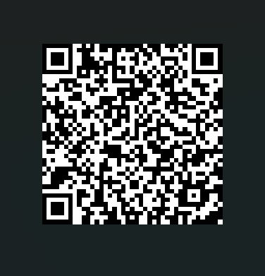
Discussion & feedback
We appreciate your feedback and we ask that you take a few minutes to complete this survey.

