Slide 1



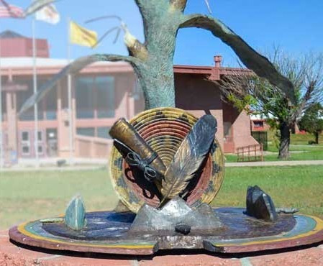

ACADEMIC ASSESSMENT & CO-CURRICULAR ALIGNMENT
PRESENTATION - 2025
Prepared By:
Prepared For:
Mikayla Largo
Director of Assessment & Curriculum
SEAL Cross-Department Strategic Planning & Assessment Retreat

Slide 2



Program & Gen Ed Assessment
Topics
New AGEC Redesign
Progress of HLC Focused Visit
Data Collection & Sustainable Assessment Processes

Slide 3

Program & Gen Ed Assessment

Slide 4

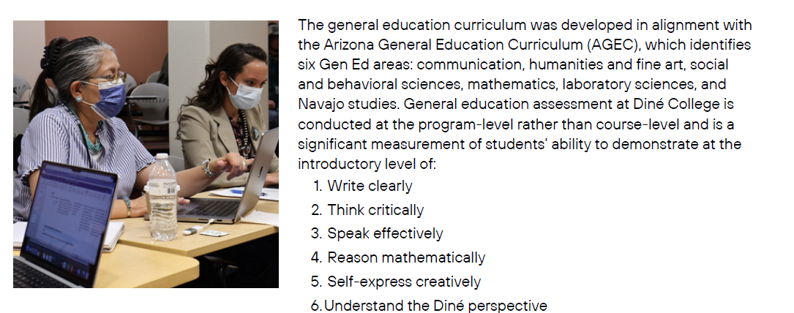
Gen Ed Assessment

Slide 5
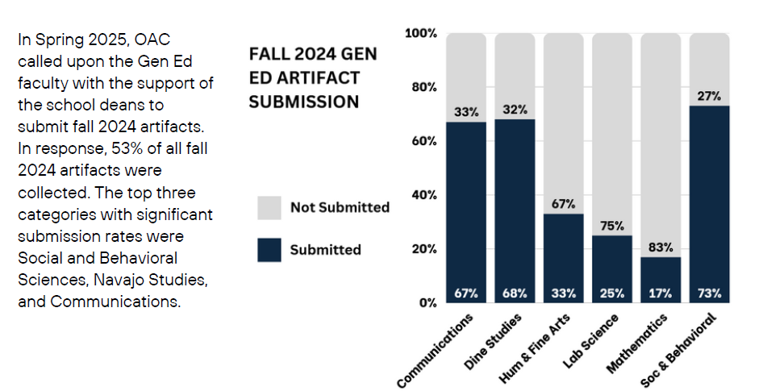
Gen Ed Artifact Submission

Slide 6
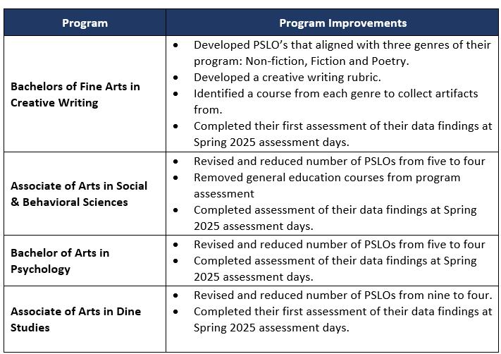
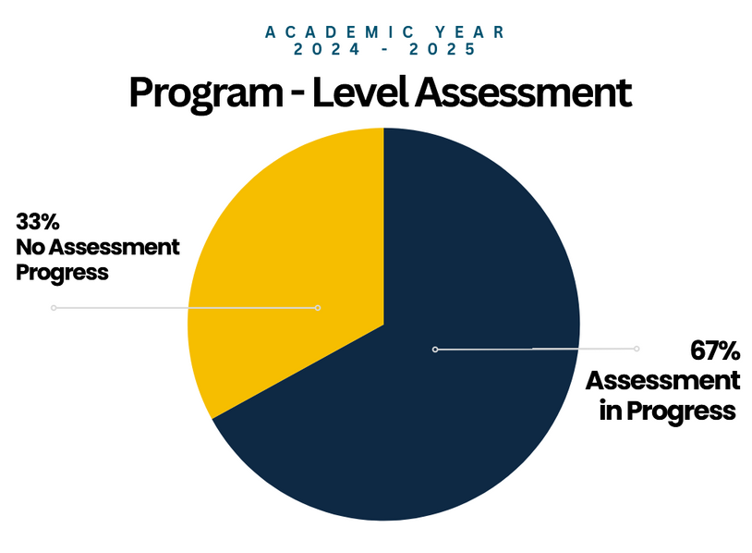
Program Assessment

Slide 7
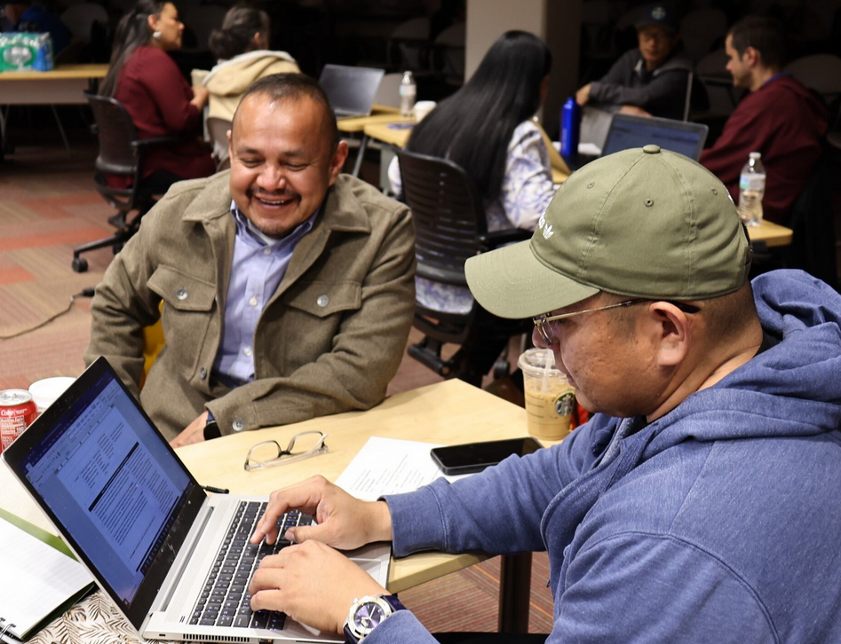

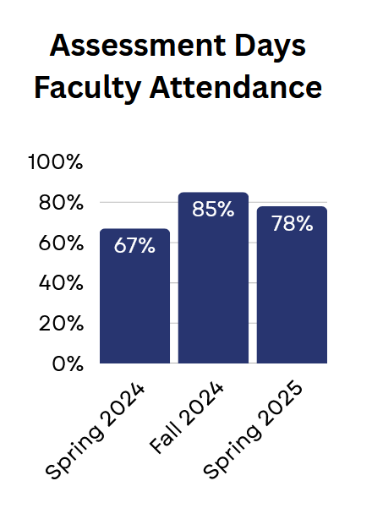
Increasing Faculty Engagement
Faculty engagement in assessment also increased in the last academic year. After a six-year hiatus, the Office of Assessment & Curriculum rebuilt their processes with a focus on increasing faculty engagement. We started from scratch to change the culture of faculty engagement in several institutional processes.
The Importance of Assessment Days
Two days dedicated to assessment of General Education and Academic Programs. Dine College focused heavily on assessment of Gen Ed in AY2425. We began including the importance of AZTransfer and AGEC and how it ties into assessment of general education.

Slide 8

AGEC REDESIGN

Slide 9

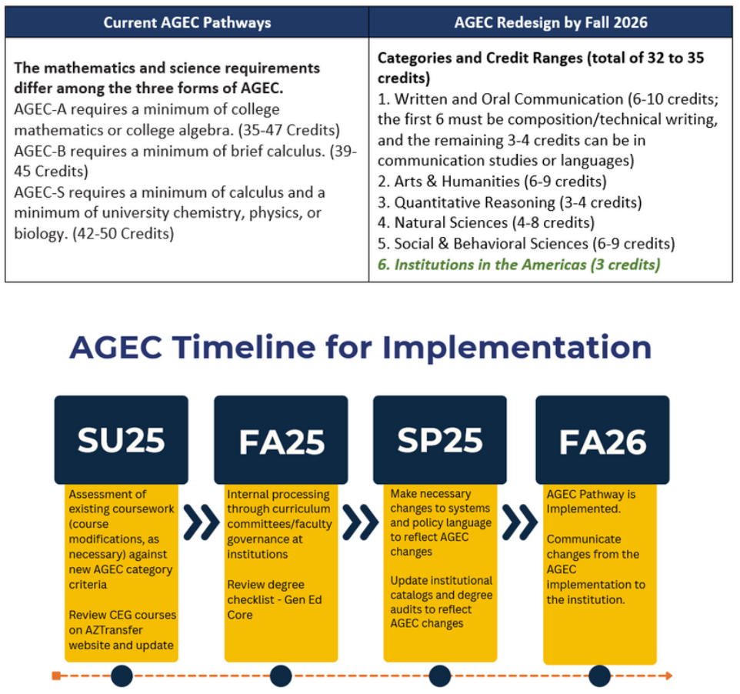
AGEC
What is it?
Why is it important?

Slide 10

ATF Disciplines
There are 43 Disciplines in AZTransfer.
Dine College participates in 31 ATF’s

Slide 11
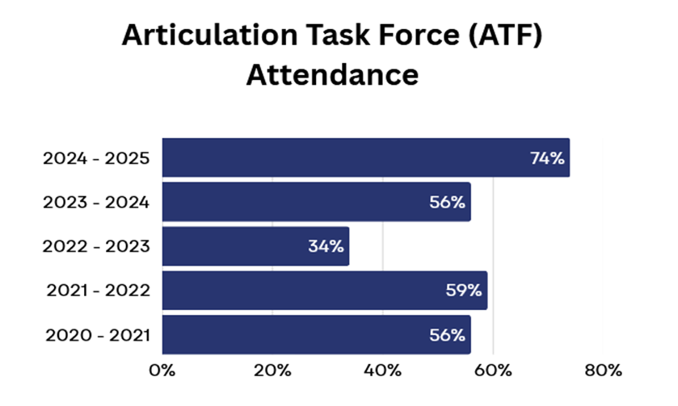
Increasing ATF Attendance
The last four academic years, faculty attendance was low due to several reasons:
  Lack of understanding
  Faculty did not want students to transfer.
  Facilitator Role was not occupied
  Gen Ed Committee did not want to oversee AGEC responsibilities.

Slide 12

Progress on HLC Focused Visit

Slide 13
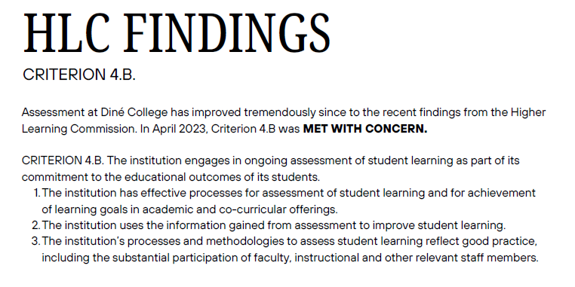

Slide 14
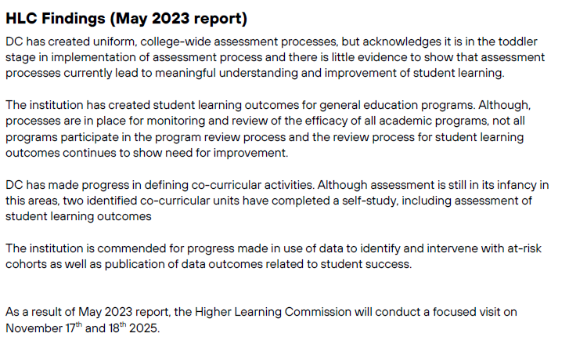

Slide 15
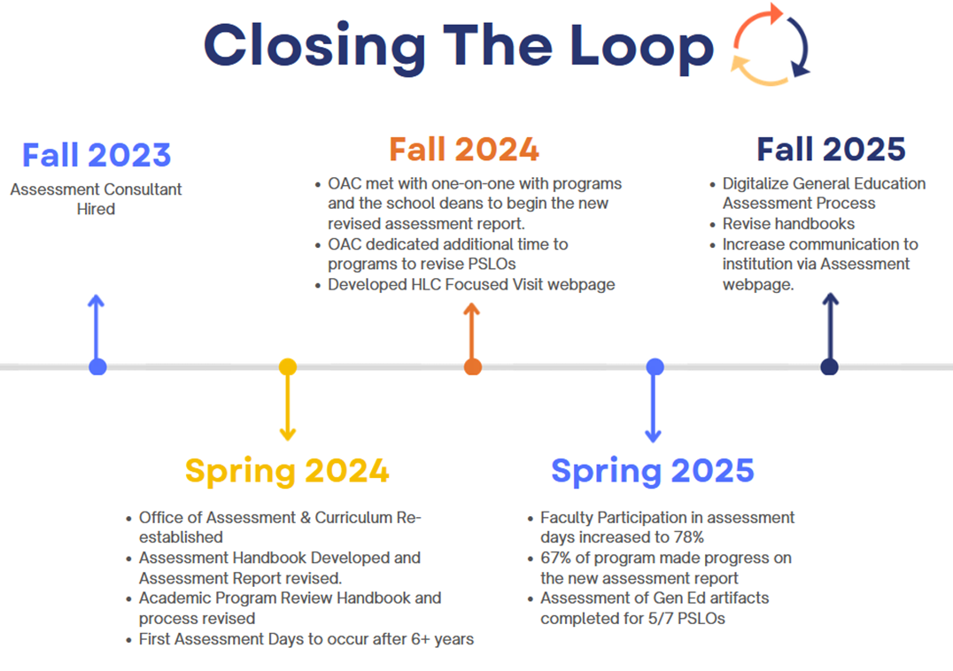
Notes:
In response to the May 2023 report – and in preparation for the November 2025 Focused Visit – Diné
College took the following steps:
Fall 2023: Hired an Assessment Consultant , Dr. Ashima Singh, who worked diligently to assess the
institution’s assessment process. Singh developed a new assessment report template and process
that reduced faculty assessment workload and called for assessment of only one or two program
outcomes per academic year.
Spring 2024: Hired a full-time Director of Assessment and Curriculum (Mikayla Largo) and reestablished
the Office of Assessment and Curriculum (OAC), housed under the Provost’s Office.
May 2024: Hosted the first faculty assessment days after a six-year pause. Attendance was low.
Summer 2024: The OAC worked to revise handbooks with the new processes for assessment and
Academic Program Reviews.
Fall 2024: OAC met one-on-one with academic programs, successfully getting 67% of programs on
board with the new assessment report and process. During this time, programs worked to revise their
program student learning outcomes (PSLOs), which had not been updated since programs were
developed. In addition, a webpage was developed to begin storing evidence file for the HLC Focused
Visit in November 2025.
Spring 2025: faculty attendance at Assessment Days increased to 78%, and faculty completed a trial
run of General Education assessment.
Fall 2025: OAC will work toward a digital and efficient process of general education assessment, and
revise handbooks and increase communication regarding assessment to the entire institution.

Slide 16
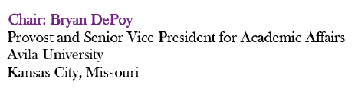
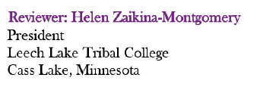
The Focused Visit
11/17 & 11/18
Focused visits occur between comprehensive evaluations and examine specific aspects of an institution. A focused visit is an evaluation of limited scope that reviews specific developments and changes or follows up on concerns identified by a previous evaluation process.
PEER REVIEWERS

Slide 17

Next Steps
  Write 100 Page Report in response to the HLC findings. This is due no later than 30 days before the Focused Visit.
  Be TRANSPARENT about our progress
  Be ACCOUNTABLE, do the work!
  Continue to make progress, slow and steady

Slide 18



Slide 19
What day is the HLC Focused Visit?

Slide 20
What is Gen Ed vs. Program Assessment?

Slide 21
What is ATF & why is it important?

Slide 22
How many ATF disciplines are there & how many include DC?

Slide 23

Data Collection & Sustainable Assessment Processes
Co-Curricular Alignment Work Session

Slide 24




THANK YOU
Contact Us For More Information
(928) 724-6968
mnetsitty@dinecollege.edu

